Slide 1
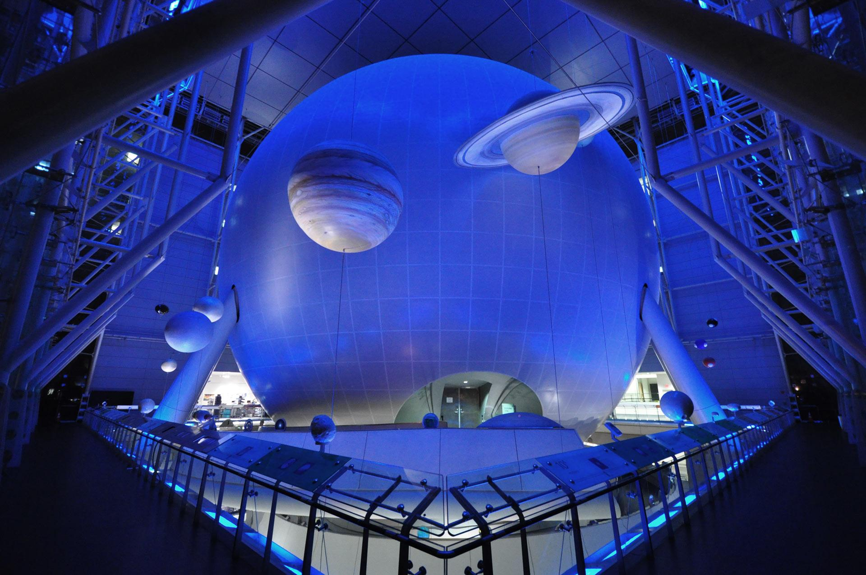
SolAR
Learn our solar system in Mixed Reality

Slide 2
User journey
Notes:
15 seconds

Slide 3
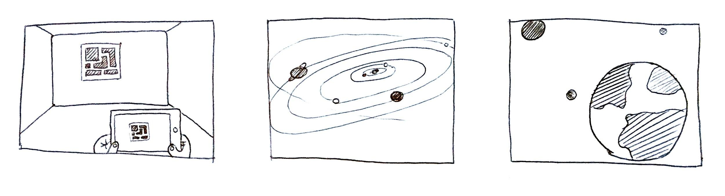

Slide 4
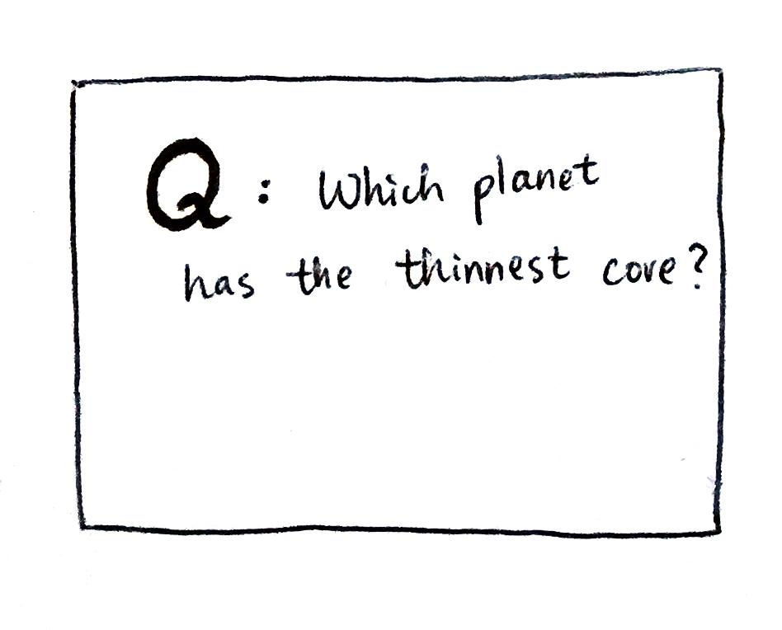

Slide 5
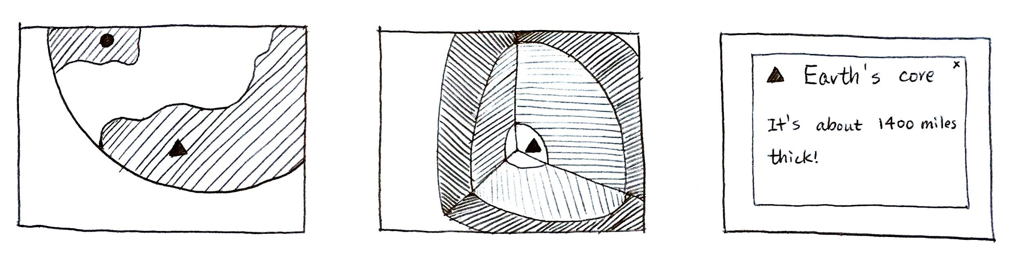

Slide 6
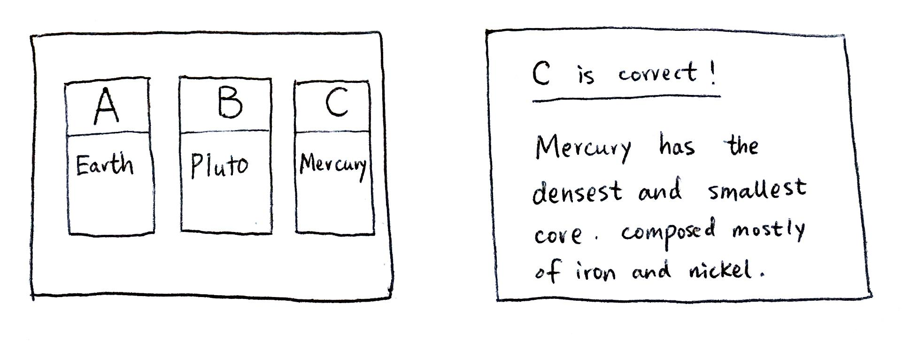

Slide 7
DEMO!

Slide 8
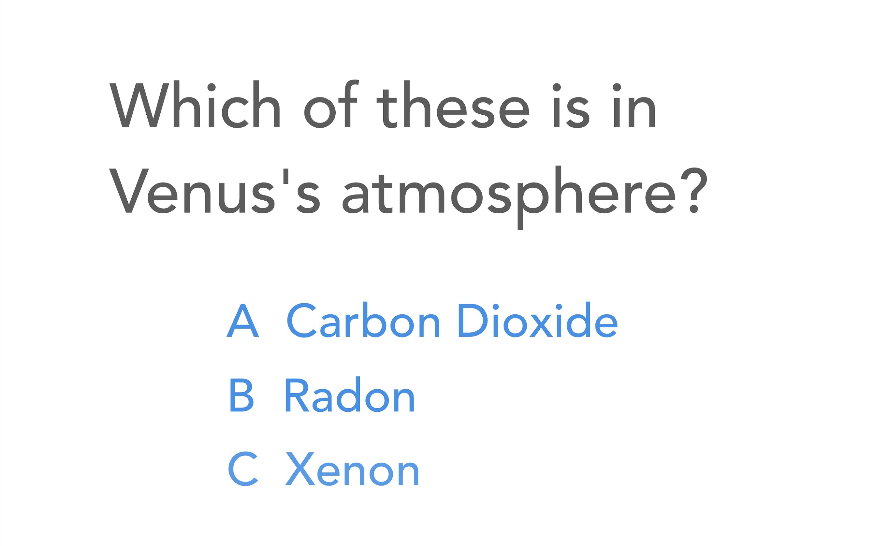
DEMO

Slide 9
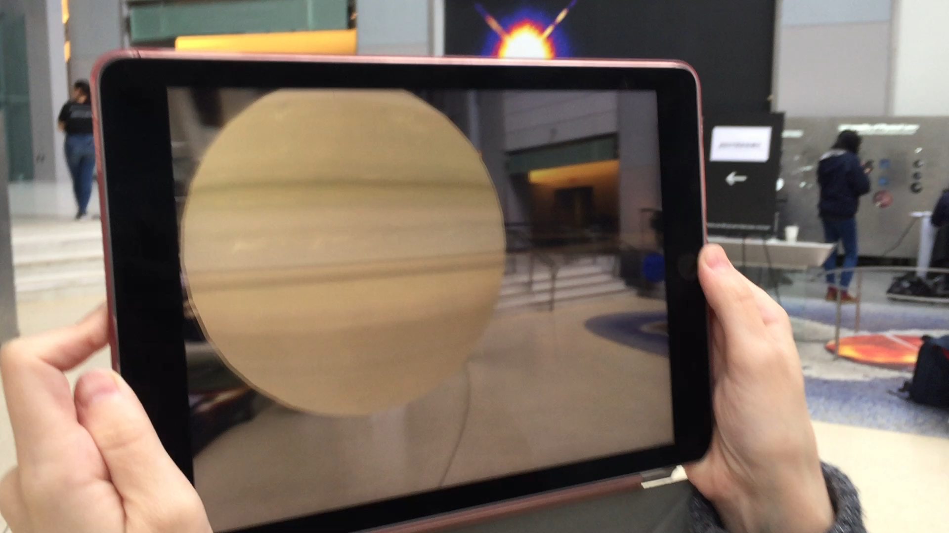
DEMO

Slide 10
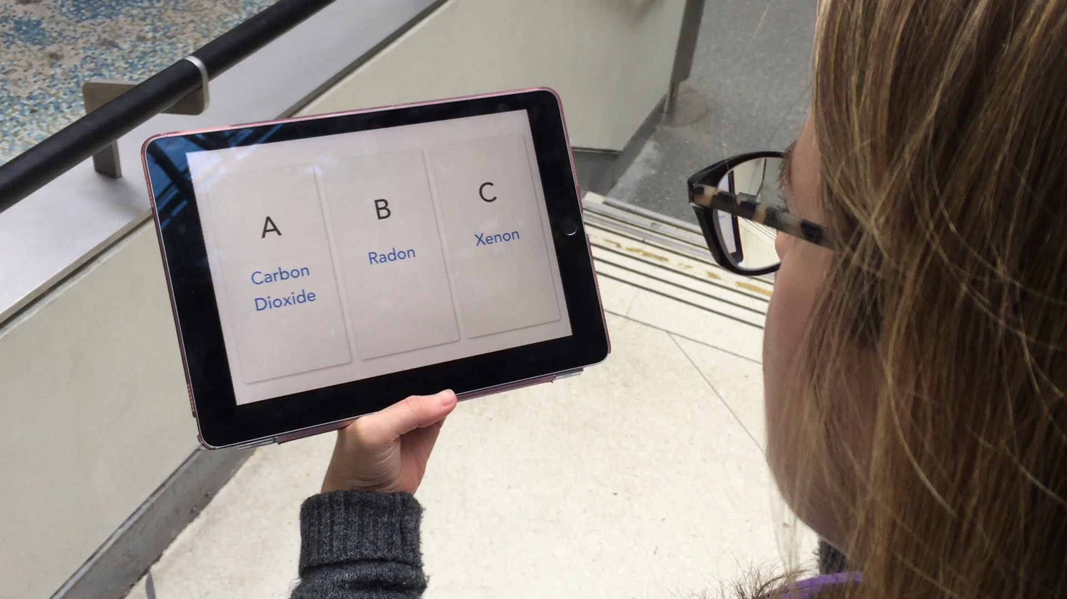
DEMO

Slide 11
Roadmap

Slide 12







Data Flow
Spreadsheet with facts
Data processing
Database
Server
3D models

Slide 13
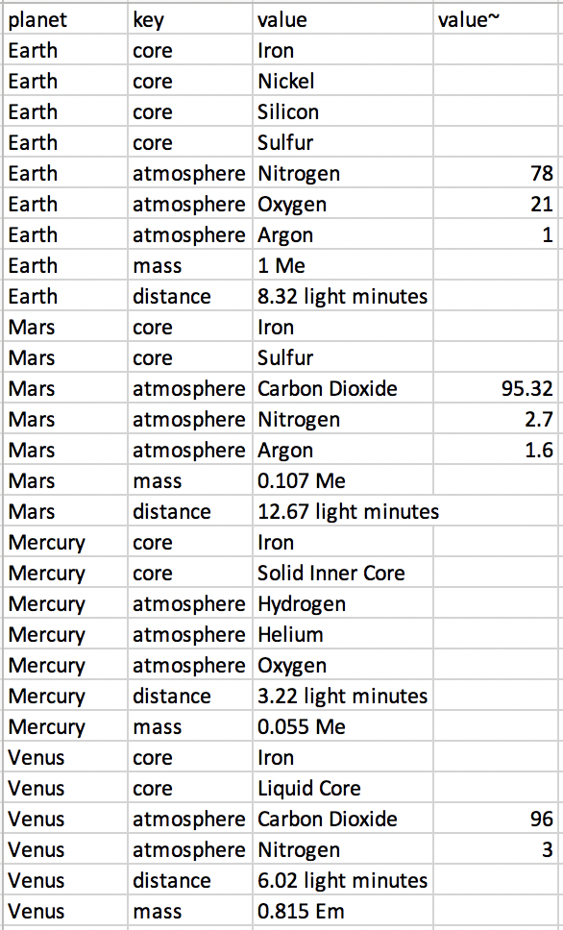
Turn Facts into Questions

Slide 14



Universal design considerations
Low vision:
Screen readers
Position trackers
Illiterate or non-native English speakers:
Strong visuals
Limited mobility:
Joystick-like
navigation

Slide 15
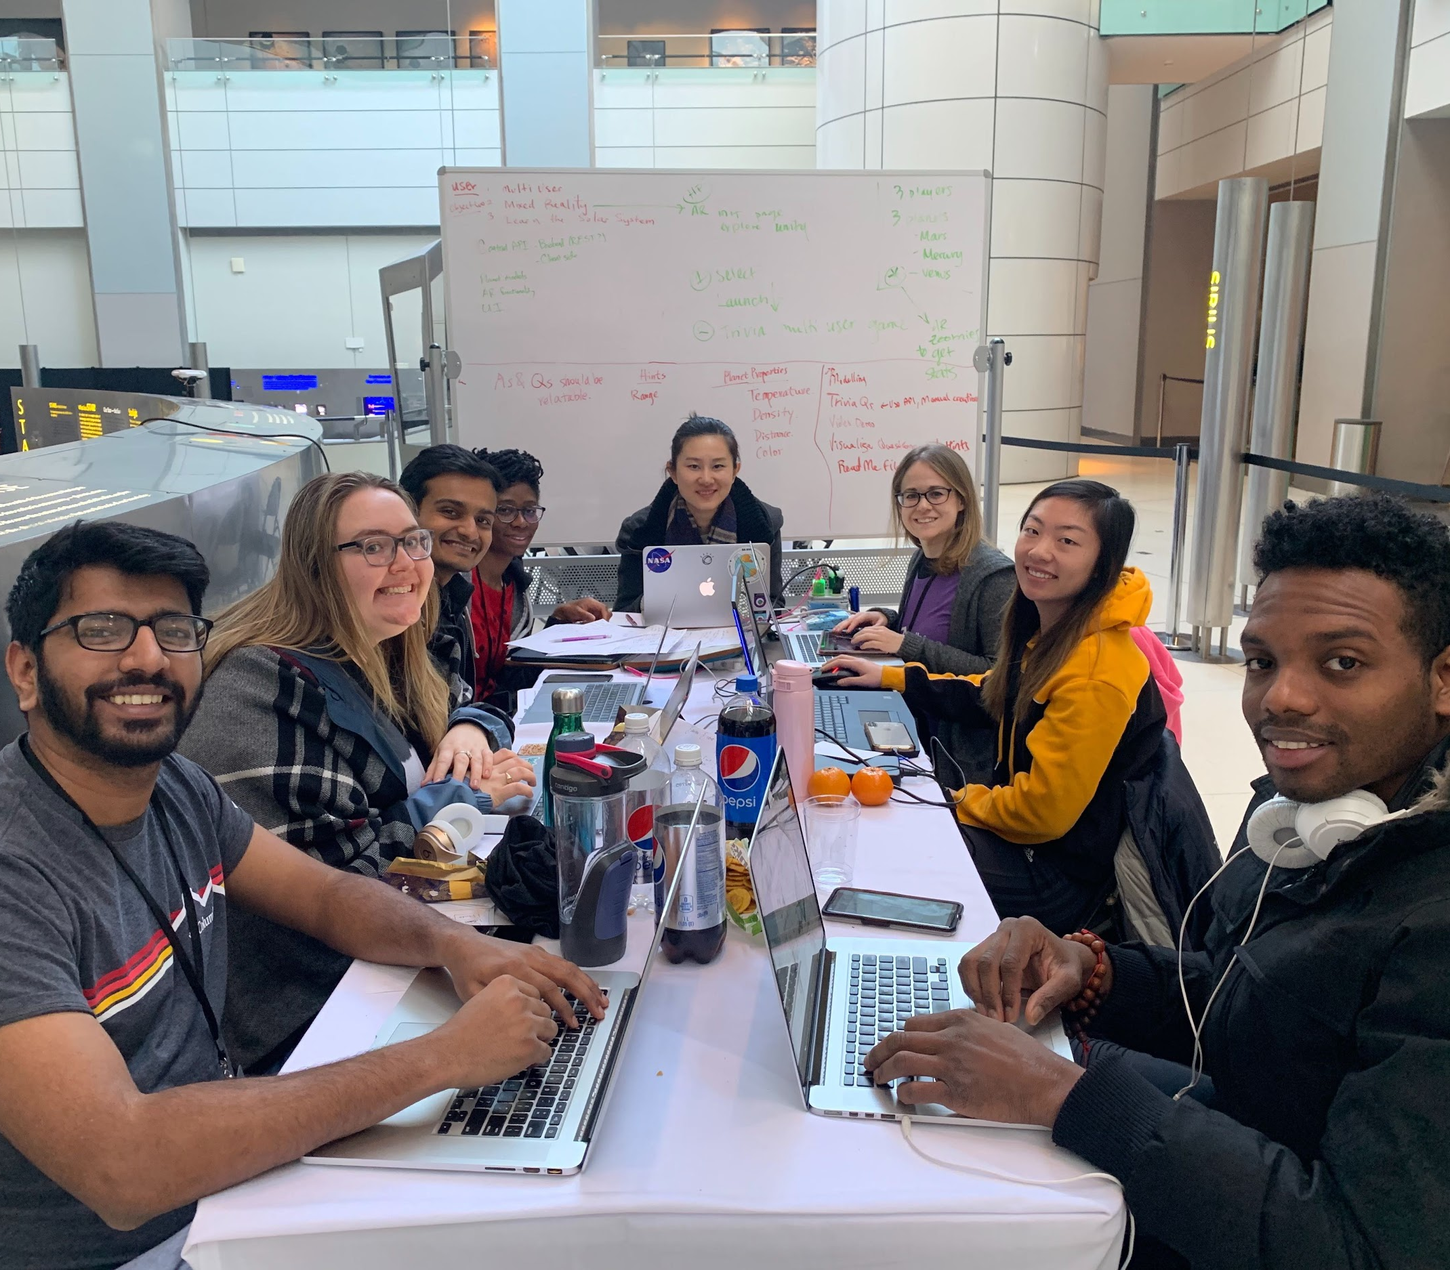
Thank you!
Team members:
Anish Parikh
Anthonia Carter
Claire Samuels
Kate Borst
Lennhy Hypolite
Nishant Mehta
Shan Liu
Stephanie Tsuei

